Slide 1

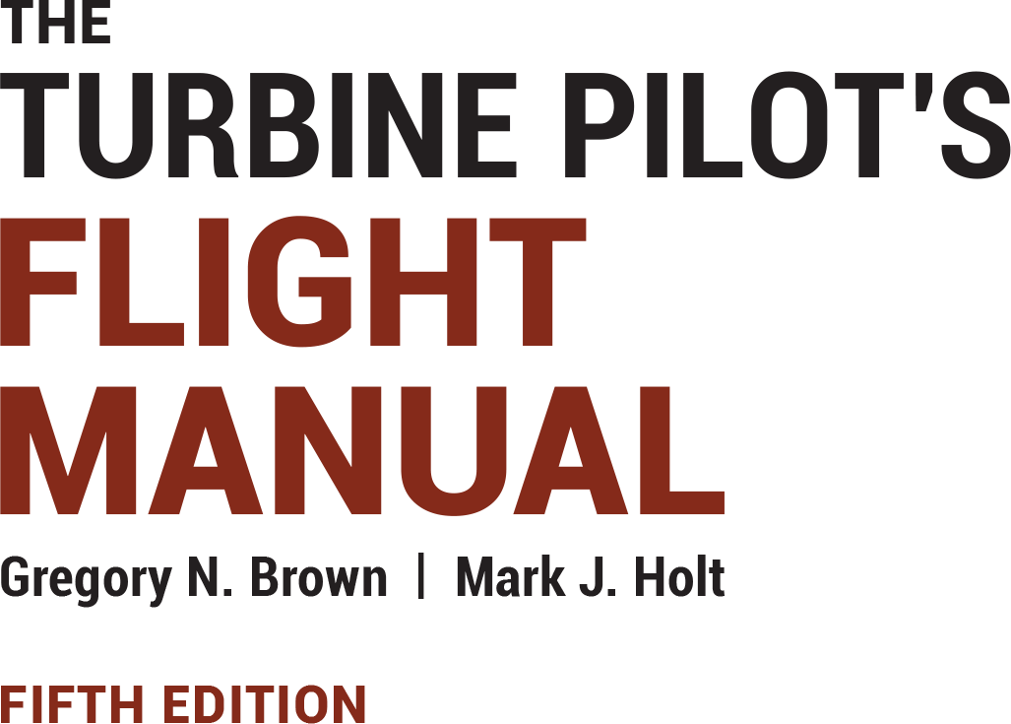
Instructor Resources
Chapter 15 Figures
Cover photo: BeautyStock – stock.adobe.com.

Slide 2
Chapter 15
Operational Information

Slide 3
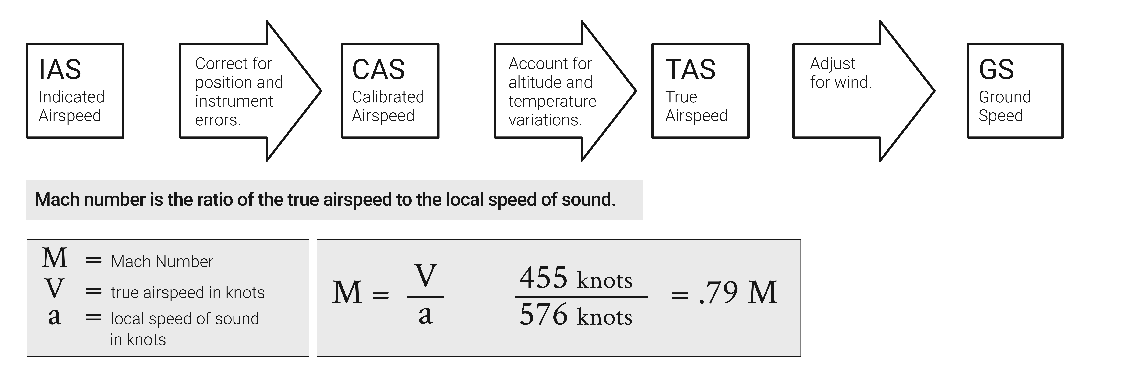
FIGURE 15.1
Aviation speeds review.

Slide 4
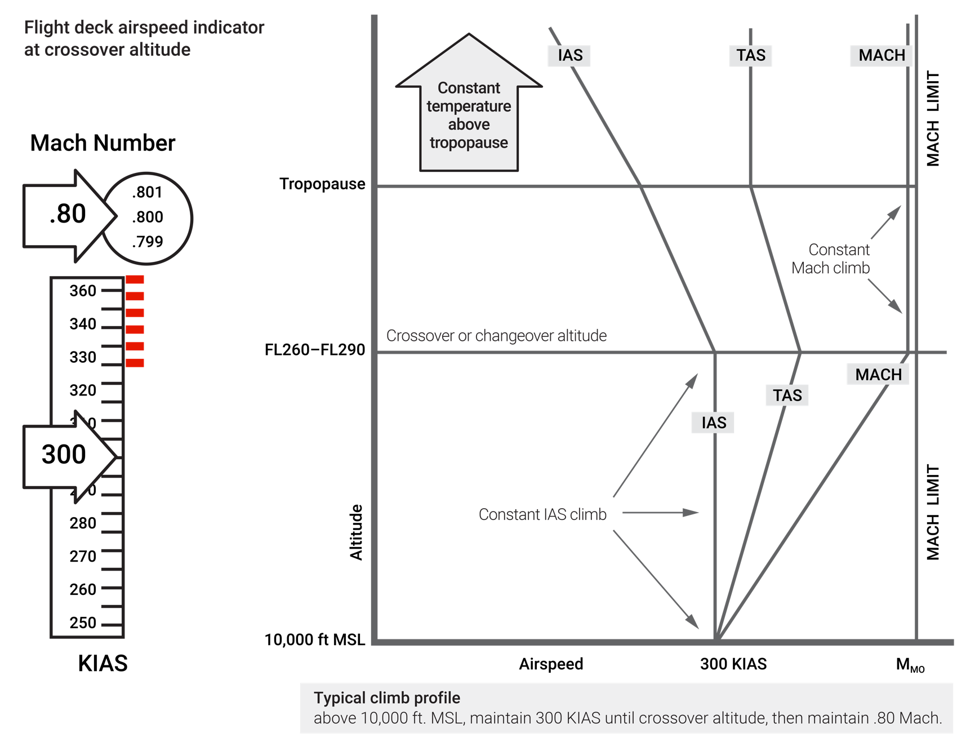
FIGURE 15.2
Constant IAS climb to crossover altitude, then constant Mach Climb.

Slide 5
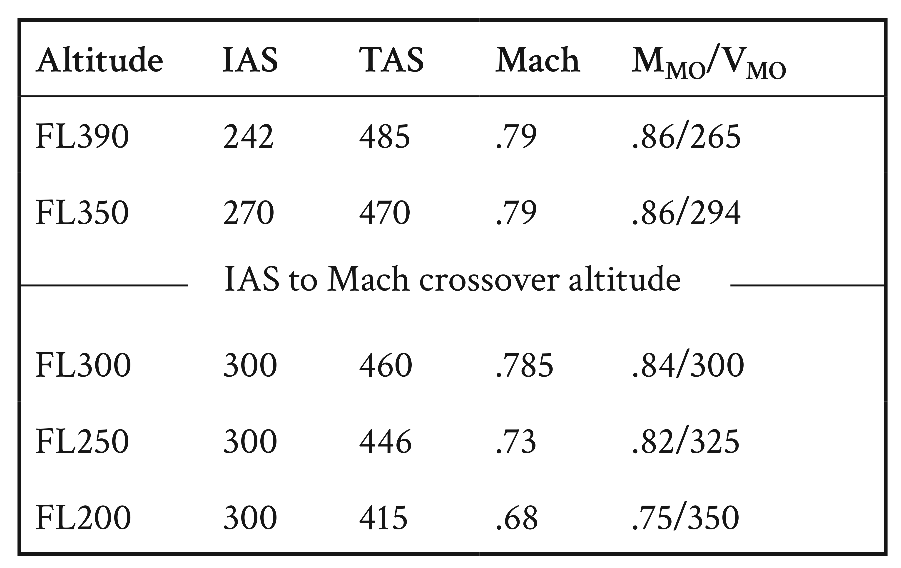
FIGURE 15.3
300 KIAS/.79 Mach climb schedule (Boeing 757-200).

Slide 6
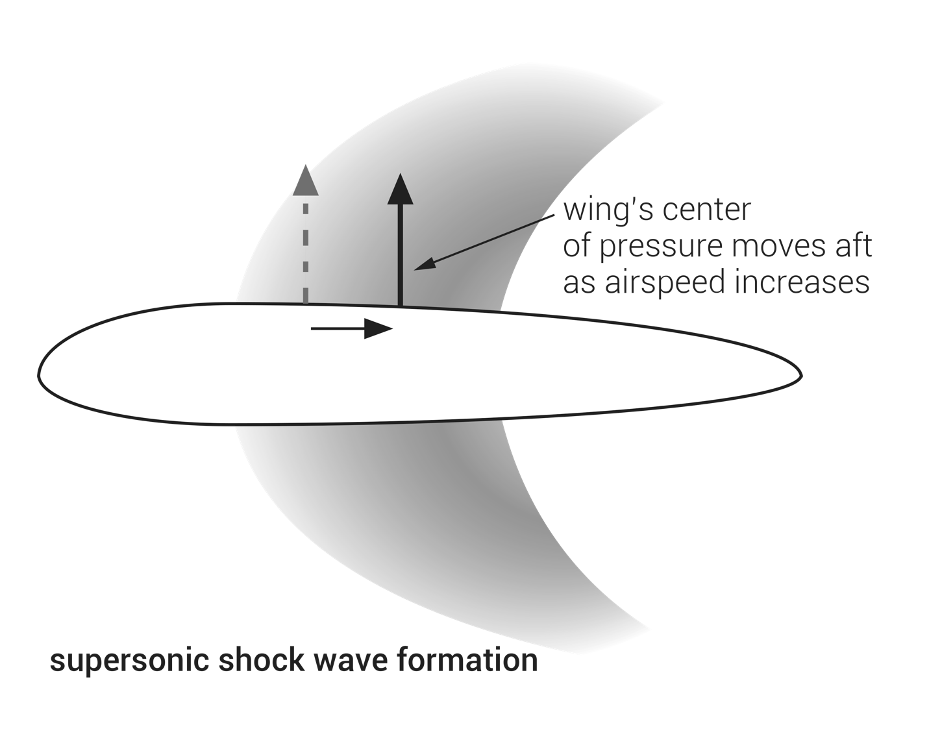
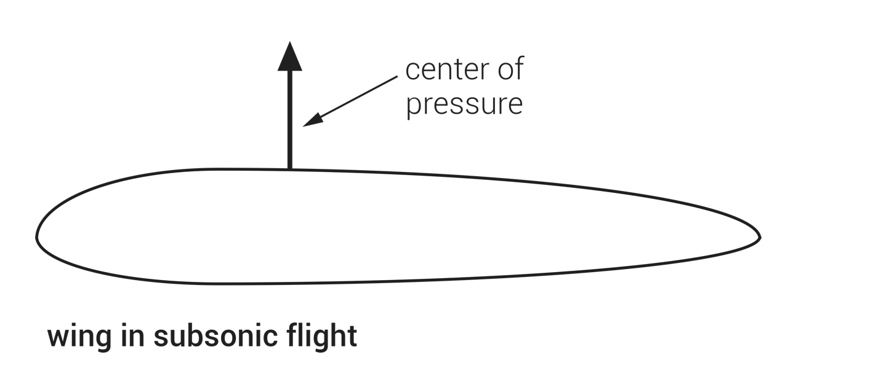
FIGURE 15.4
Supersonic shock wave formation on an airfoil.

Slide 7
FIGURE 15.5
“Coffin corner” and buffet margins.

Slide 8
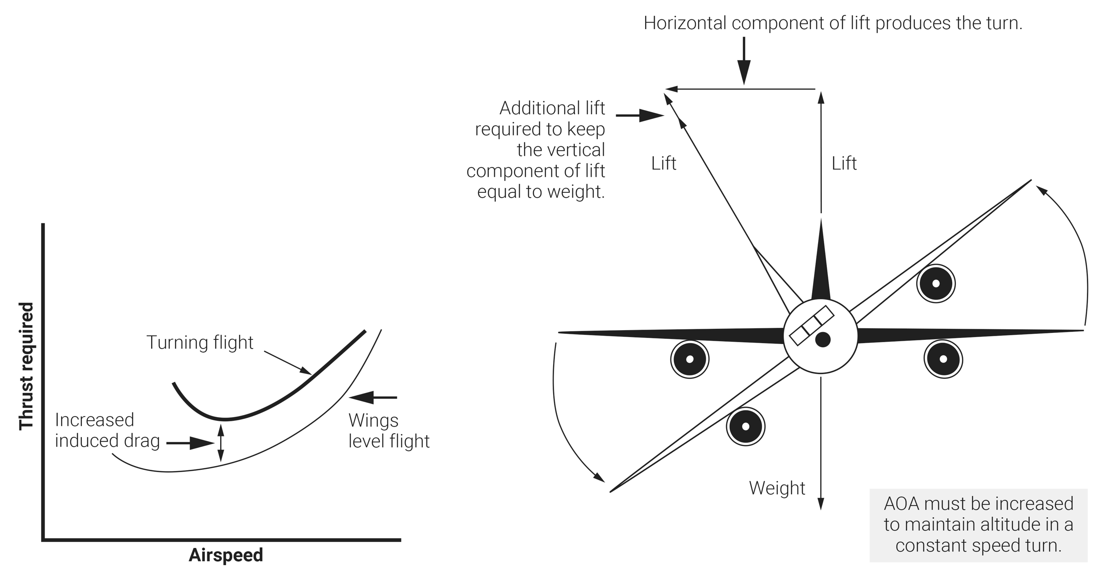
FIGURE 15.6
Effect of turning on performance.

Slide 9
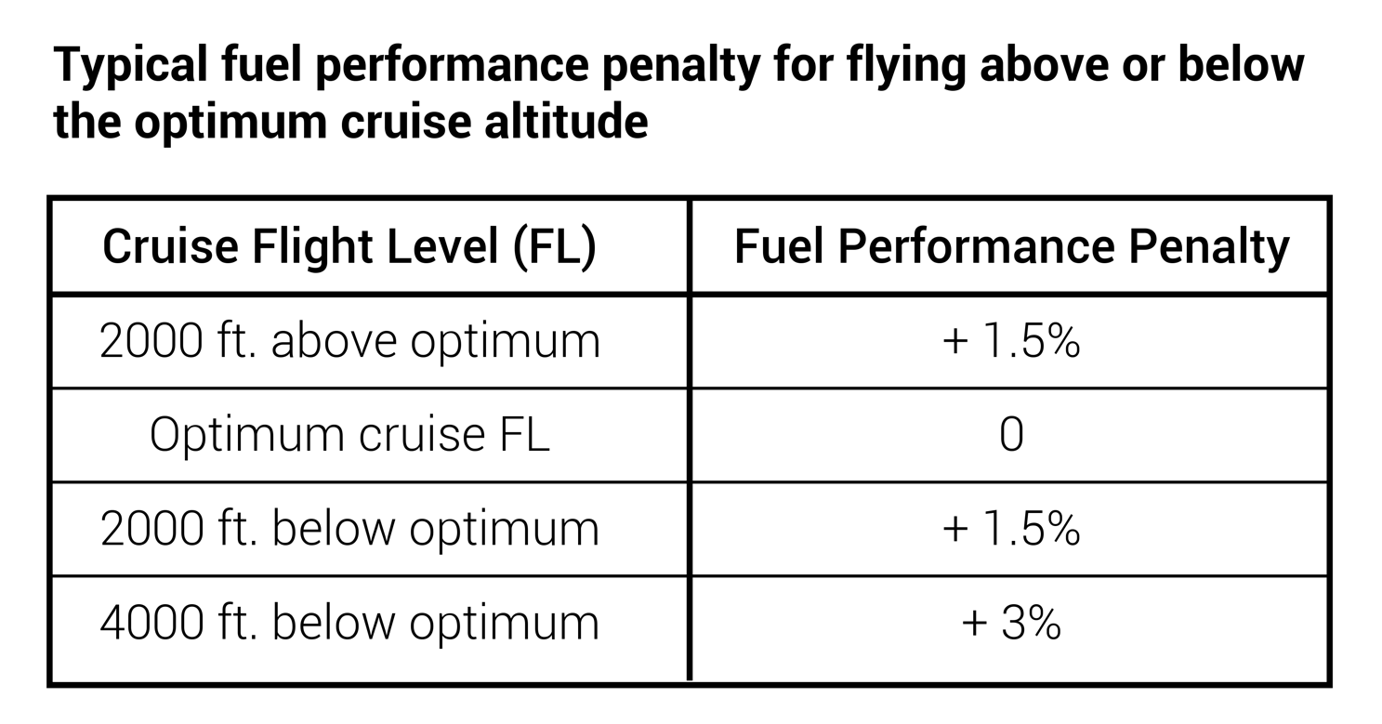
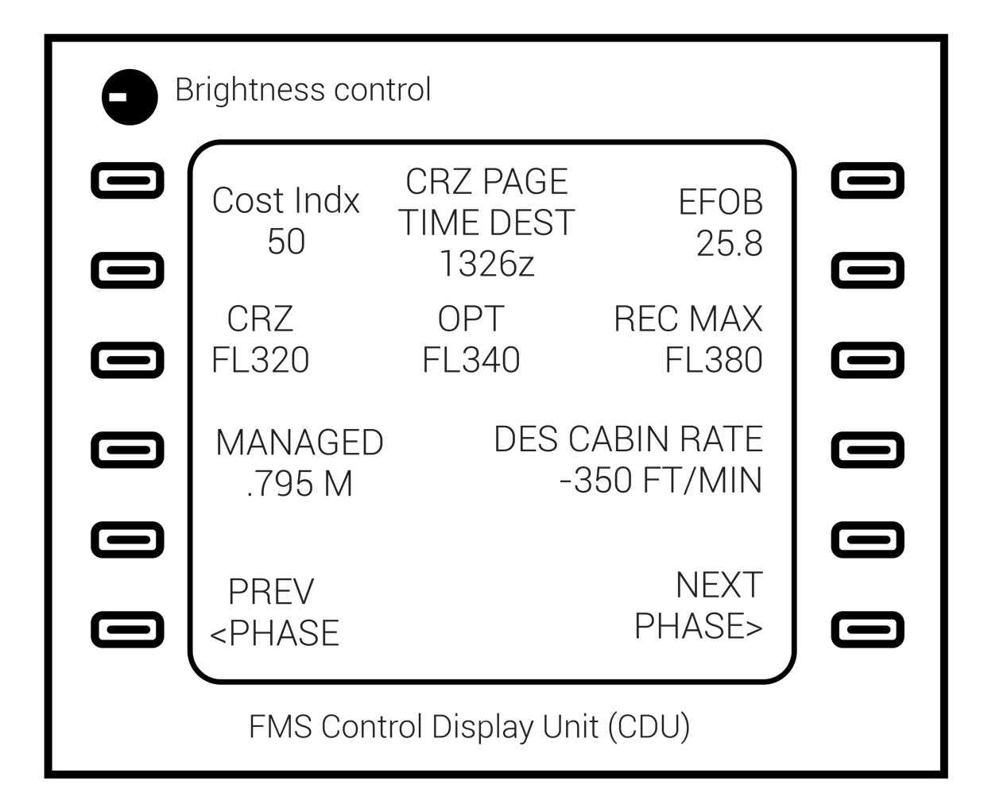
FIGURE 15.7
Flight management-generated optimum cruise altitude.

Slide 10
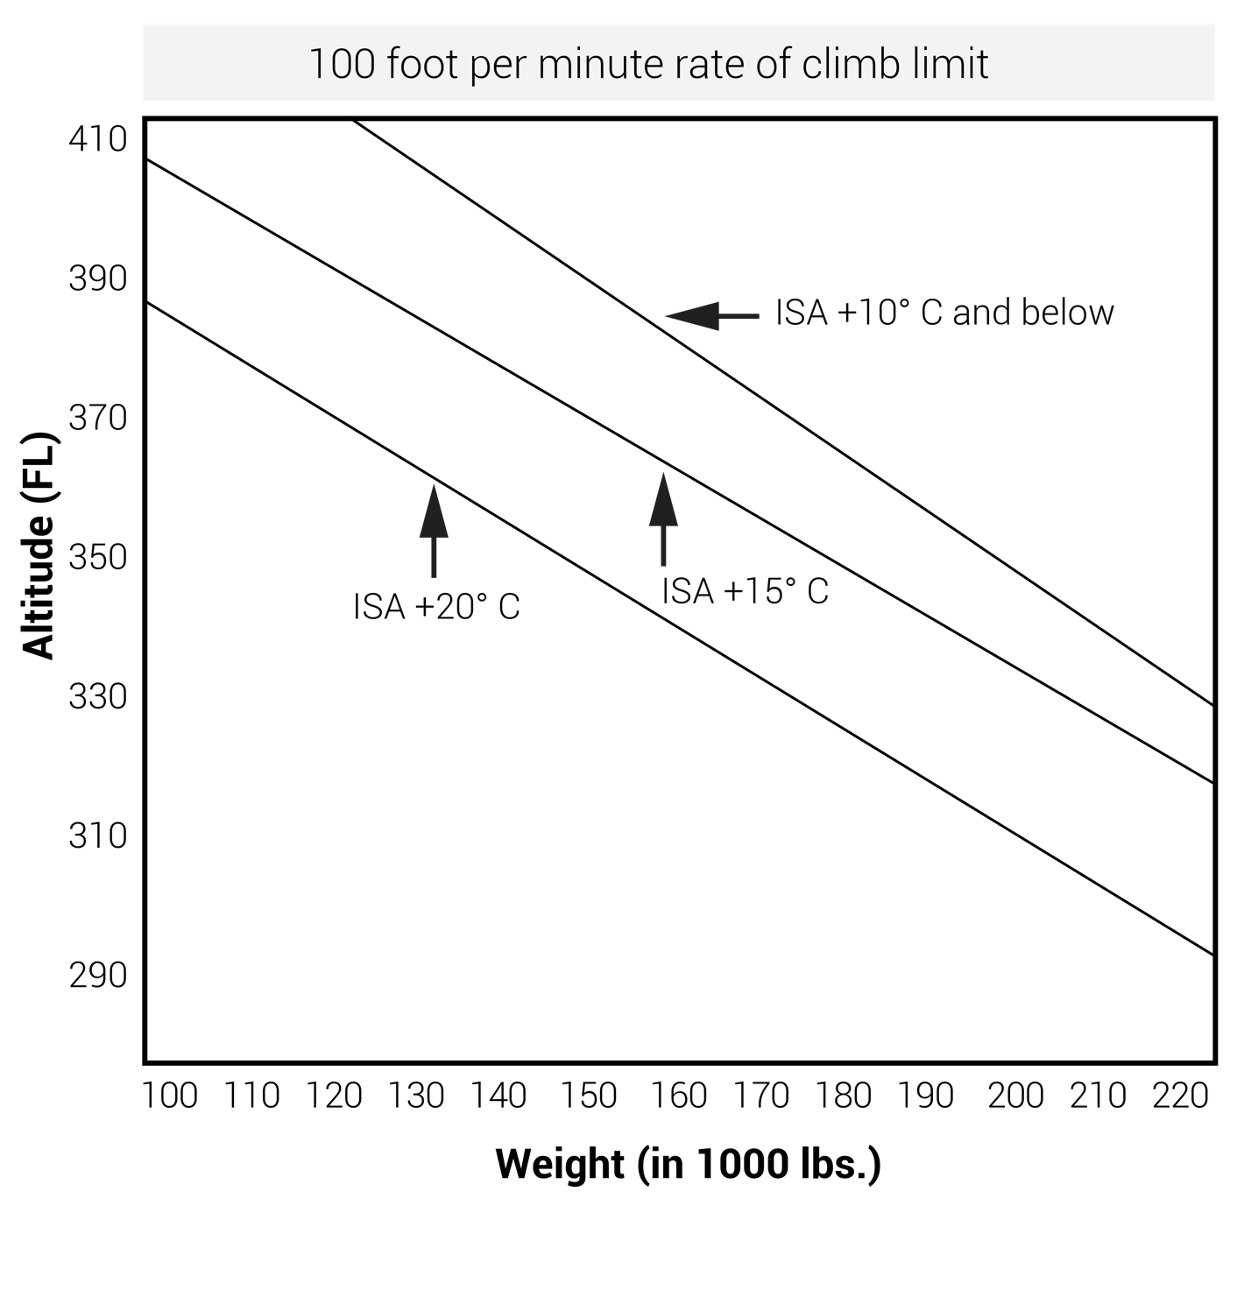
FIGURE 15.8
Temperature’s effect on altitude capability (generic jet aircraft).

Slide 11
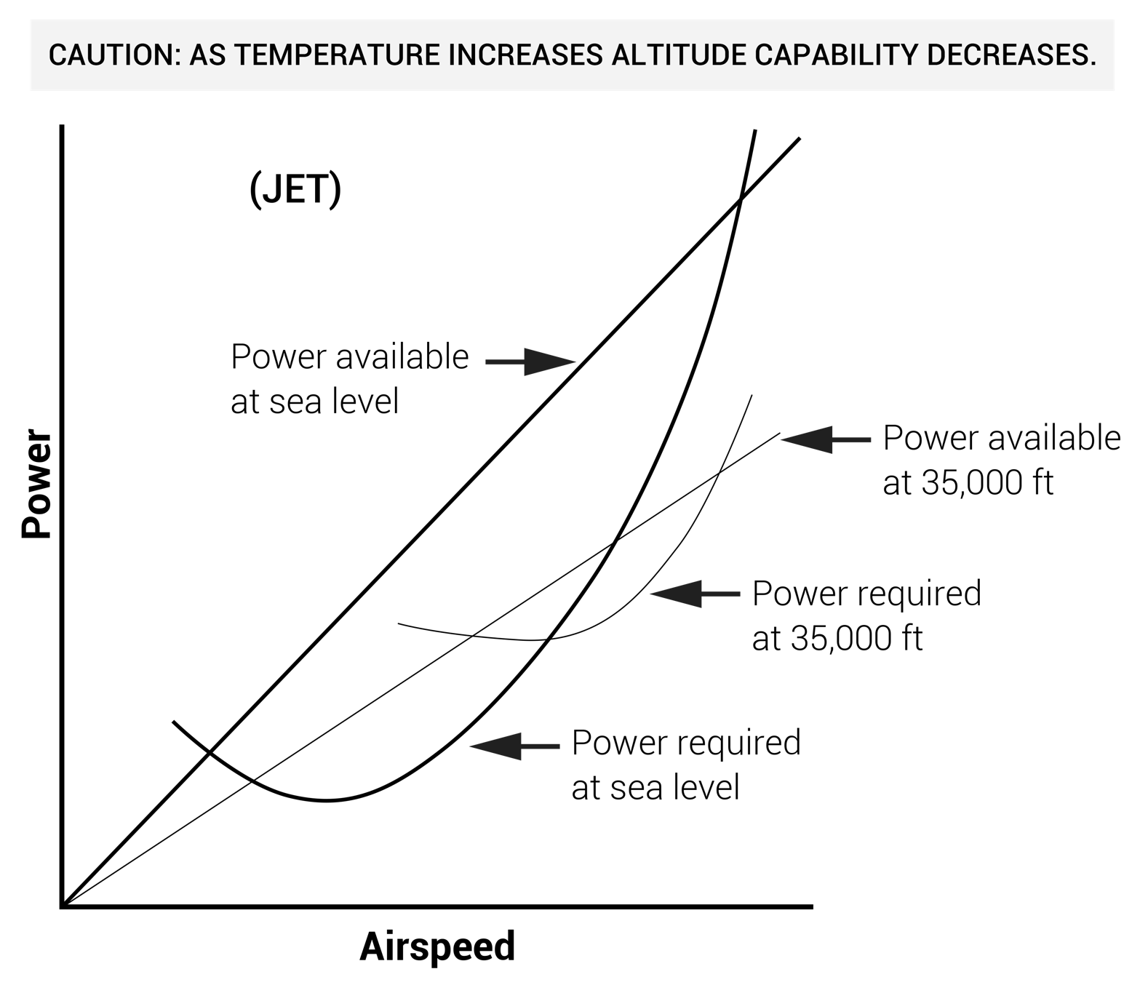
FIGURE 15.9
The effect of altitude and temperature on performance.

Slide 12
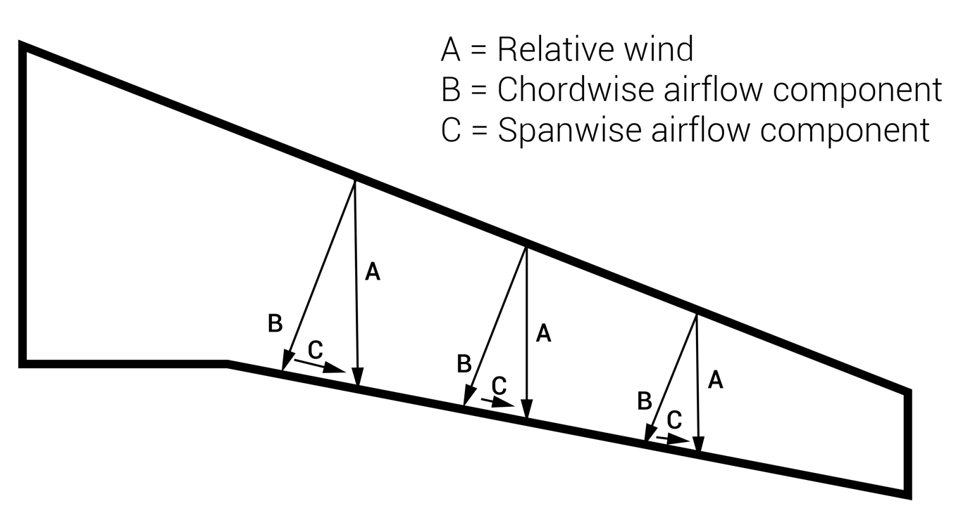
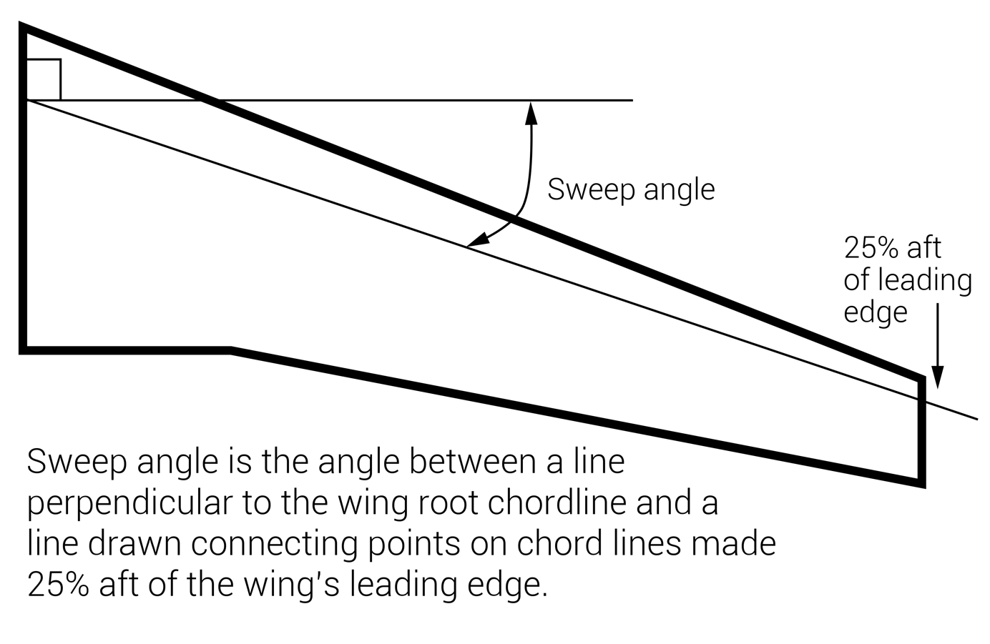
FIGURE 15.10
Swept wing

Slide 13
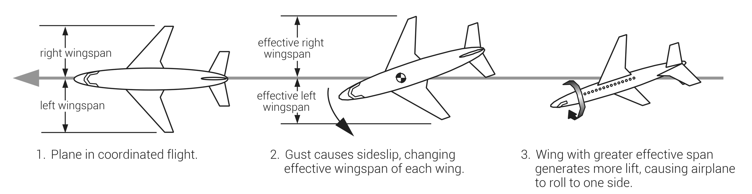
(continued)
FIGURE 15.11 (1 of 2)
Dutch roll.

Slide 14
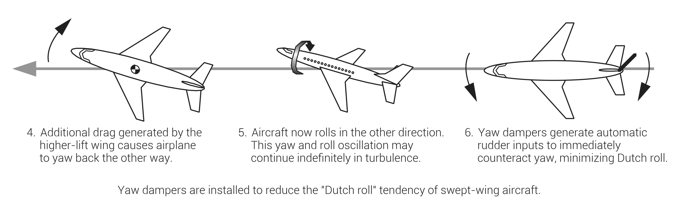
FIGURE 15.11 (2 of 2)
Dutch roll.

Slide 15
FIGURE 15.12
Winglets.

Slide 16
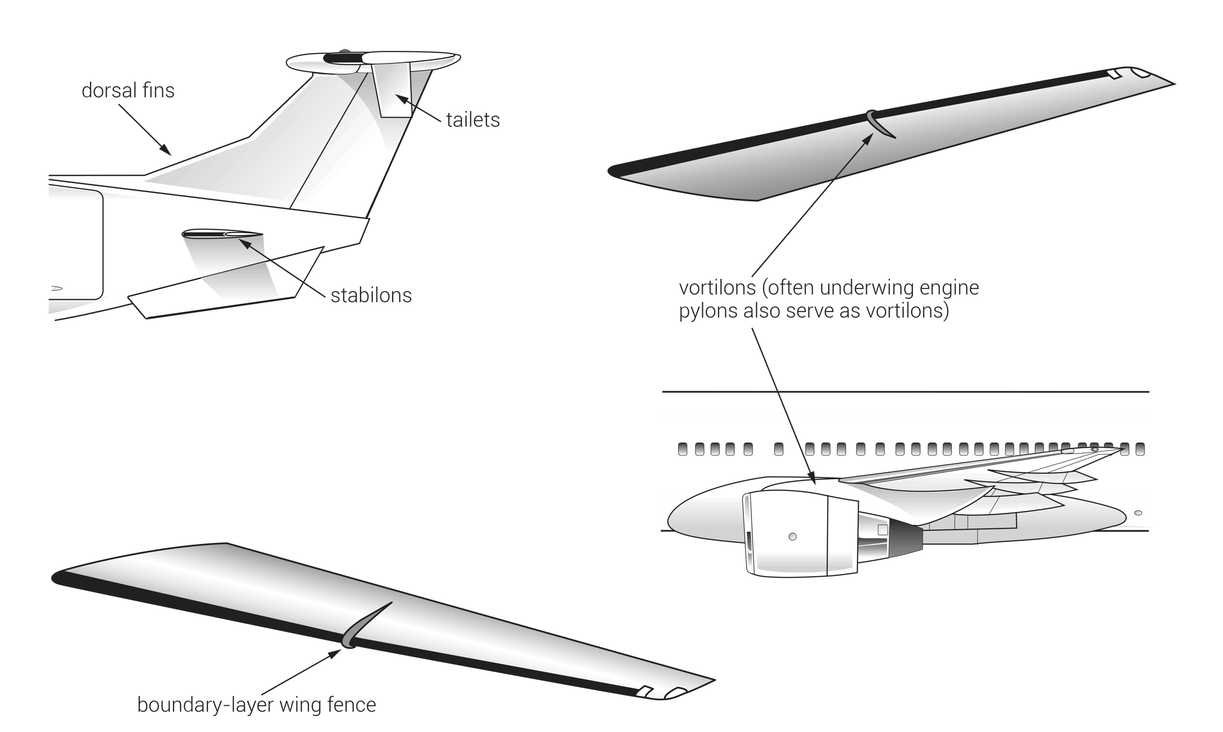
(continued)
FIGURE 15.13 (1 of 2)
Tailets, vortex generators, boundary-layer wing fences, vortilons, stabilons, and ventral fins.

Slide 17
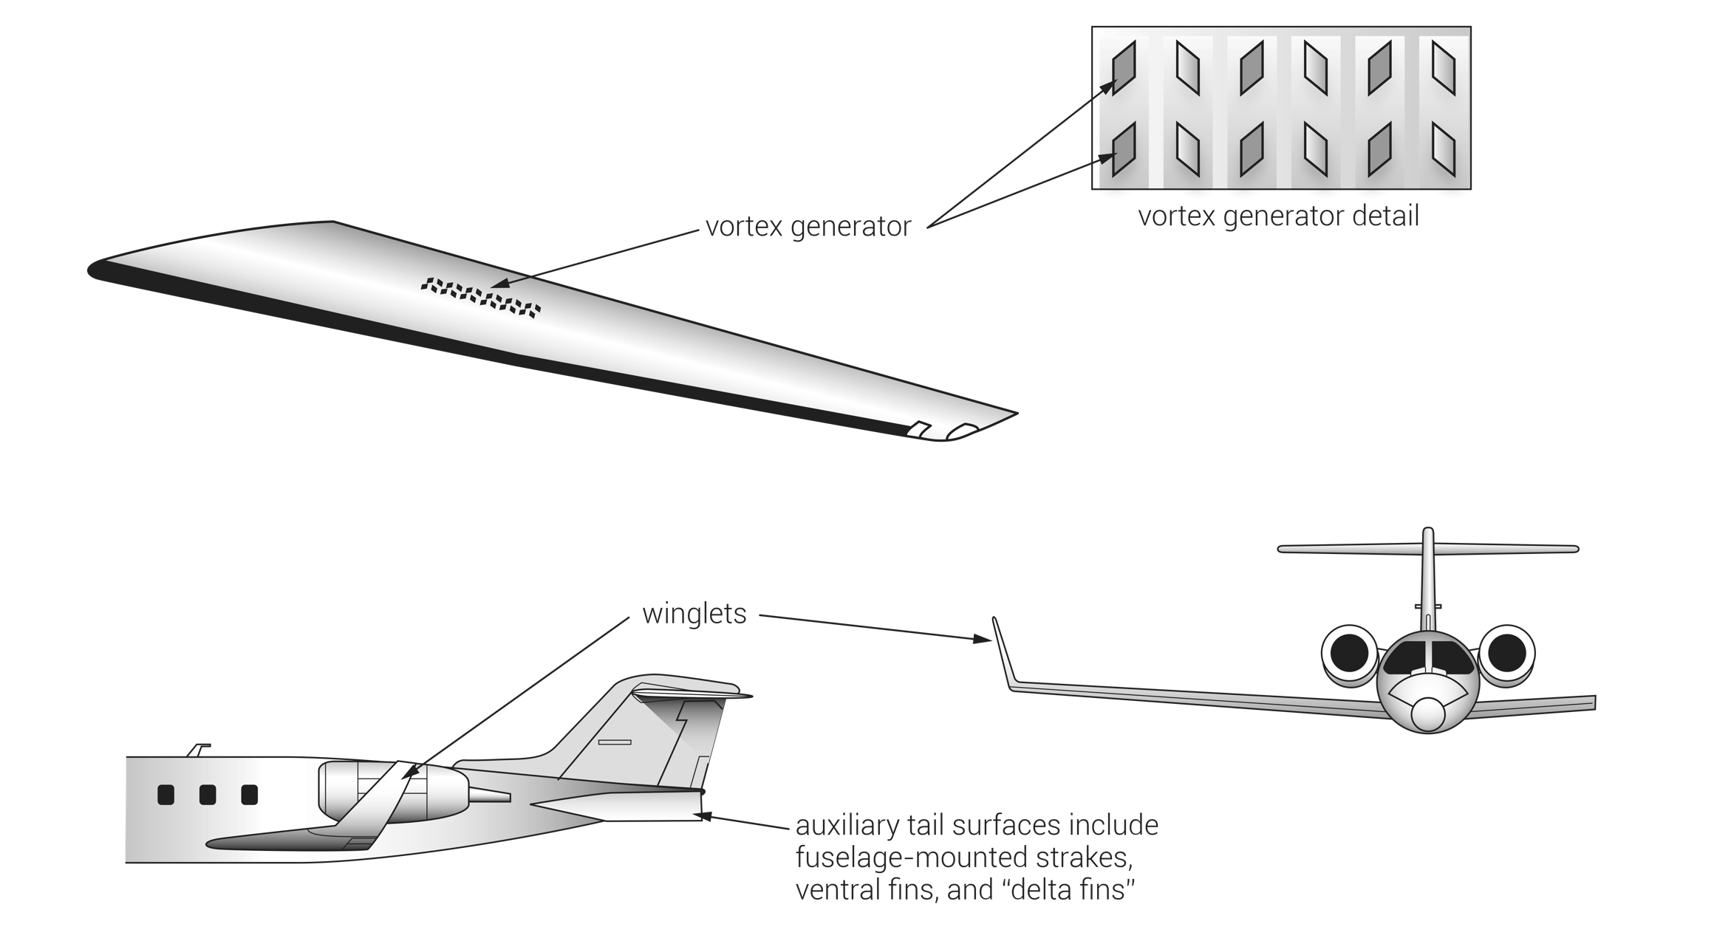
FIGURE 15.13 (2 of 2)
Tailets, vortex generators, boundary-layer wing fences, vortilons, stabilons, and ventral fins.

Slide 18
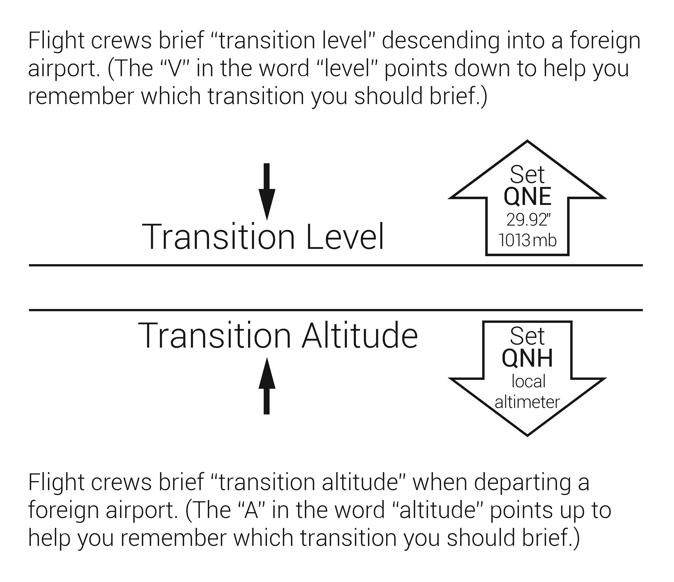
FIGURE 15.14
International altimetry.

Slide 19
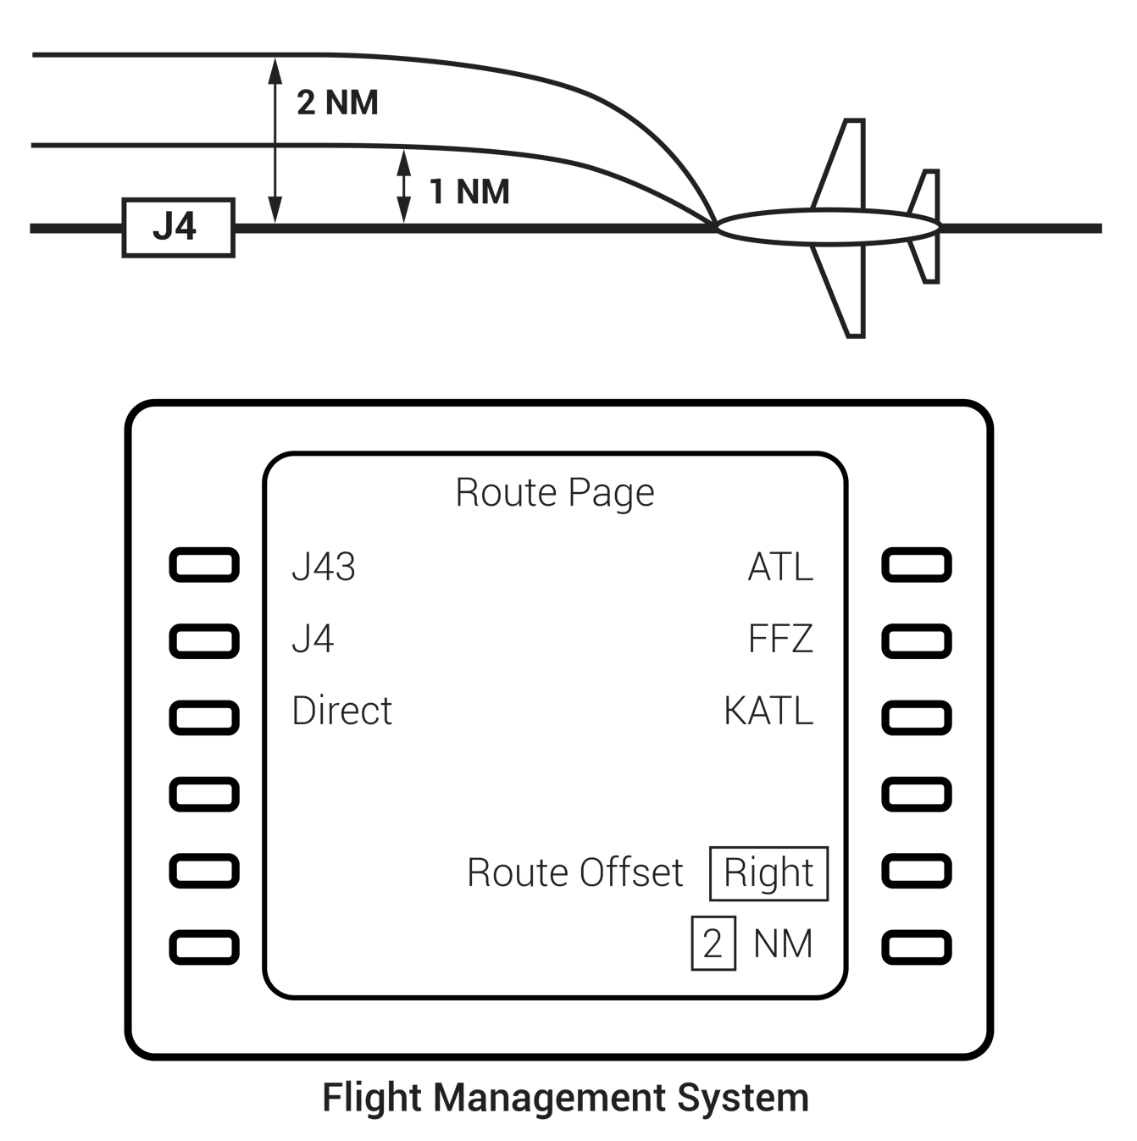
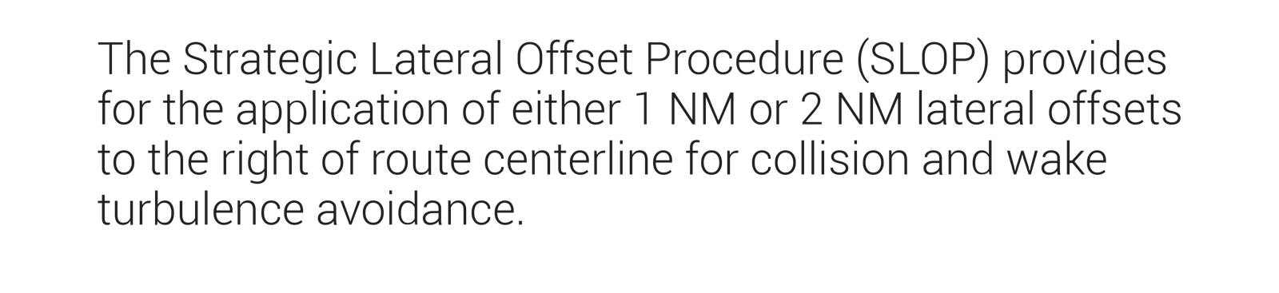
FIGURE 15.15
Strategic Lateral Offset Procedure (SLOP).

Slide 20
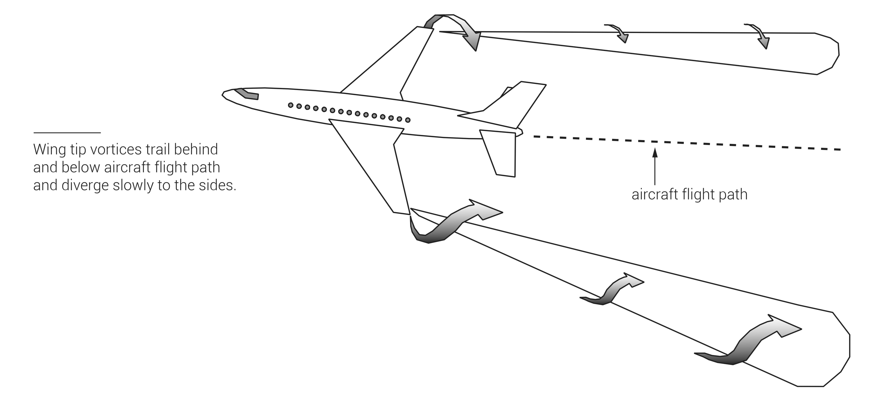
FIGURE 15.16
Wing tip vortices.

Slide 21
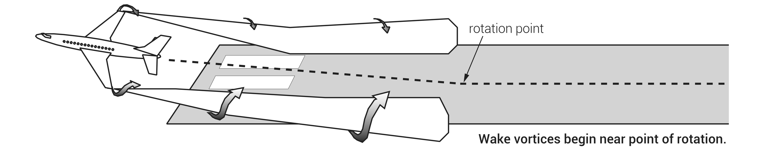
(continued)
FIGURE 15.17 (1 of 2)
Wing tip vortices on takeoff and landing.

Slide 22
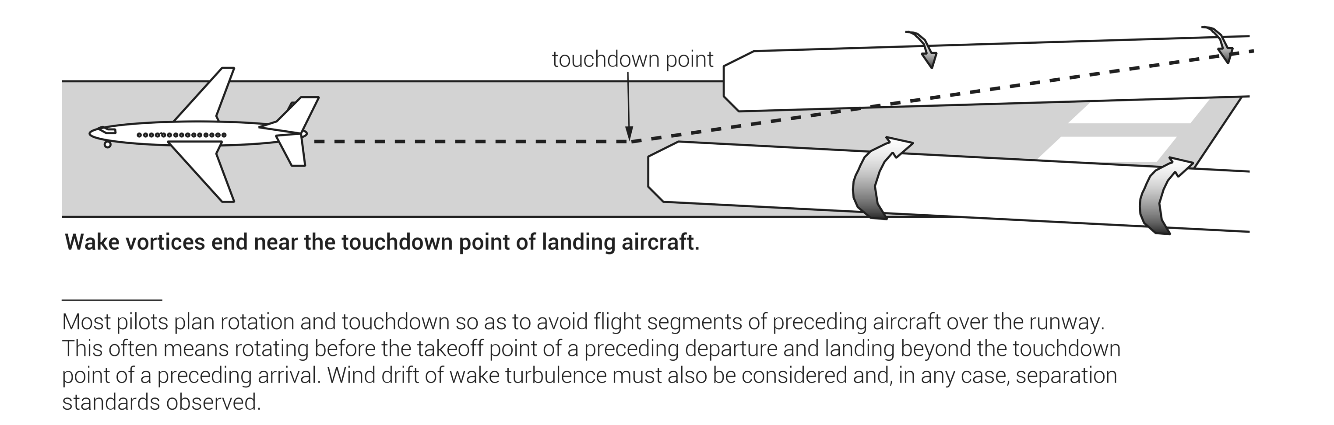
FIGURE 15.17 (2 of 2)
Wing tip vortices on takeoff and landing.

Slide 23
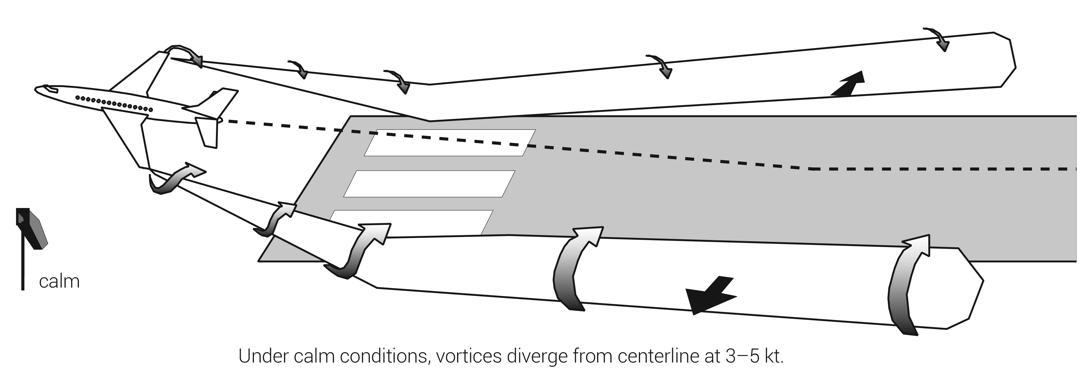
(continued)
FIGURE 15.18
(1 of 2)
Effect of crosswind on wing tip vortices.

Slide 24
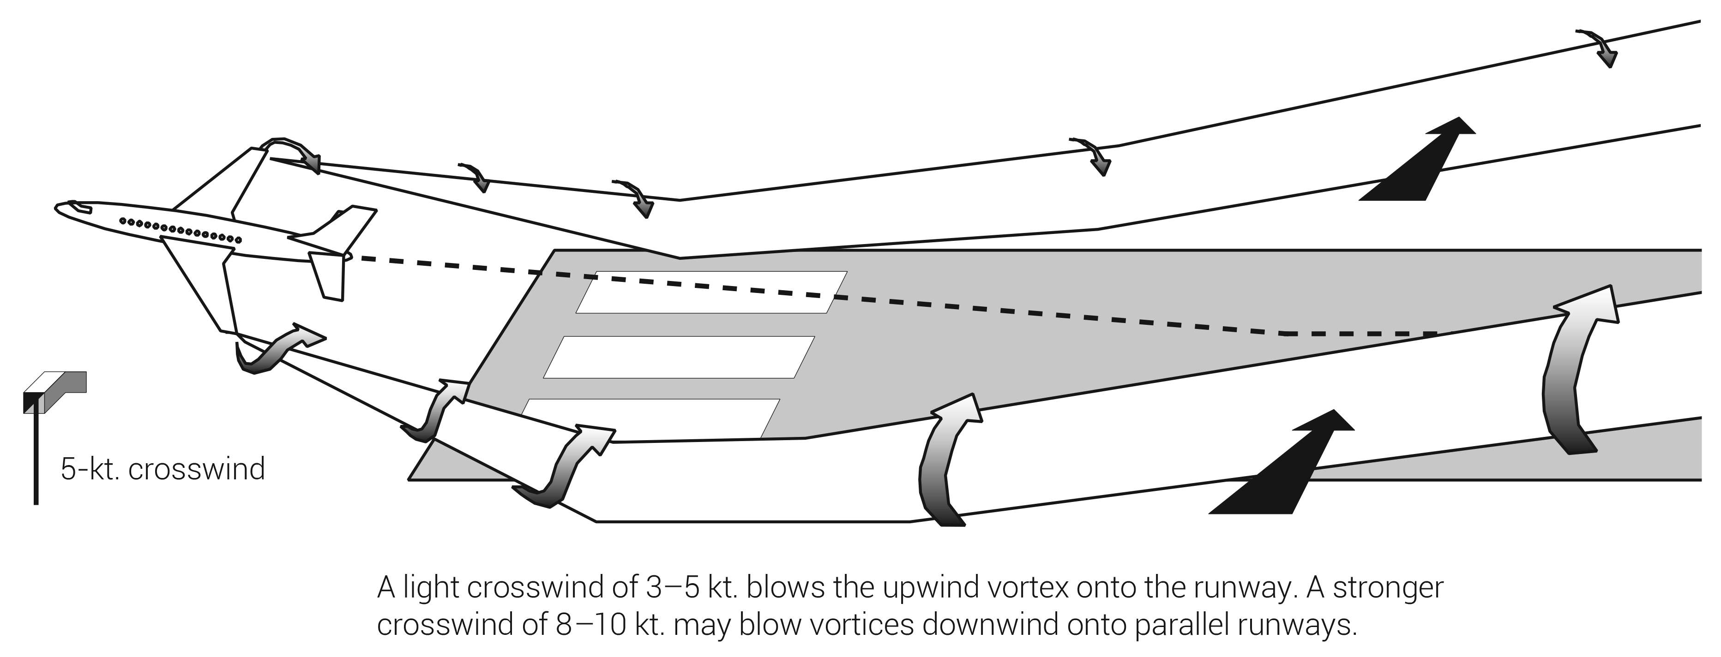
FIGURE 15.18
(2 of 2)
Effect of crosswind on wing tip vortices.

